Slide 1

Parallel Programming in C with MPI and OpenMP
Michael J. Quinn

Slide 2
Chapter 3
Parallel Algorithm Design

Slide 3
Outline
Task/channel model
Algorithm design methodology
Case studies

Slide 4
Task/Channel Model
Parallel computation = set of tasks
Task
  Program
  Local memory
  Collection of I/O ports
Tasks interact by sending messages through channels

Slide 5
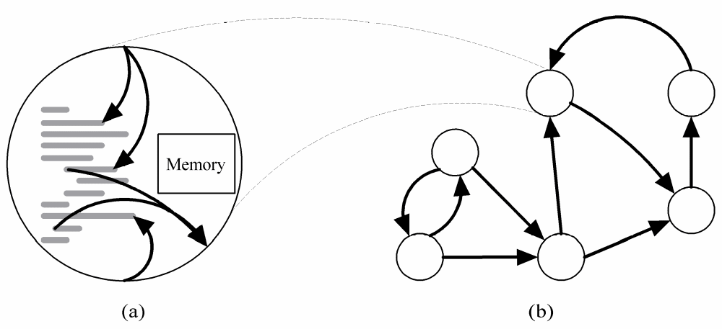
Task/Channel Model
Task
Channel

Slide 6
Foster’s Design Methodology
Partitioning
Communication
Agglomeration
Mapping

Slide 7
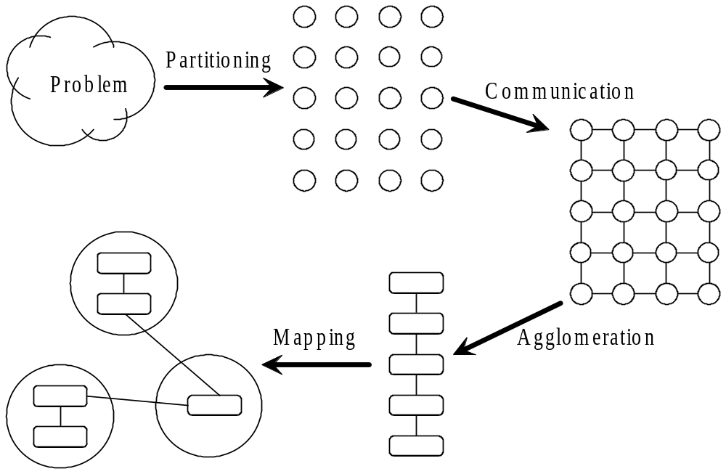
Foster’s Methodology

Slide 8
Partitioning
Dividing computation and data into pieces
Domain decomposition
  Divide data into pieces
  Determine how to associate computations with the data
Functional decomposition
  Divide computation into pieces
  Determine how to associate data with the computations

Slide 9
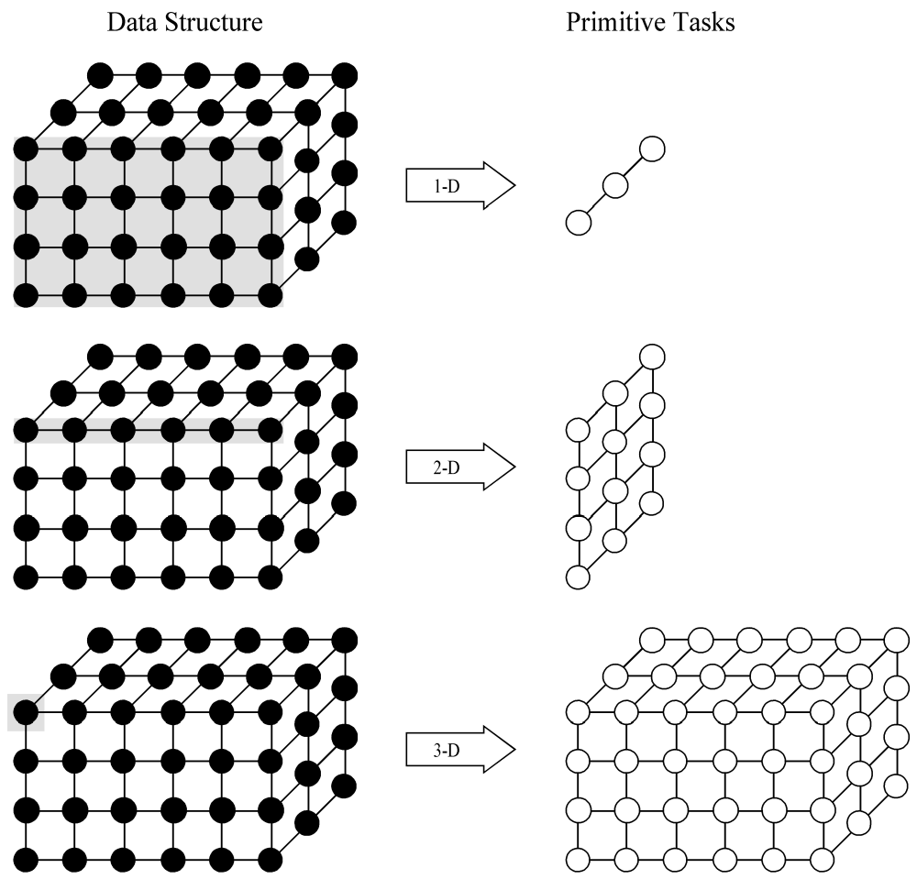
Example Domain Decompositions

Slide 10
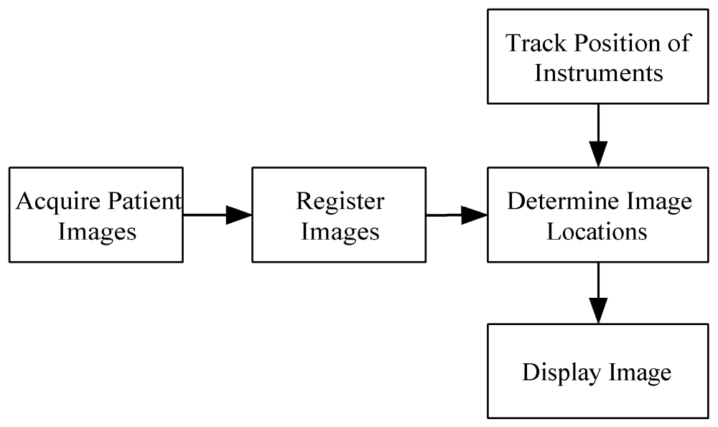
Example Functional Decomposition

Slide 11
Partitioning Checklist
At least 10x more primitive tasks than processors in target computer
Minimize redundant computations and redundant data storage
Primitive tasks roughly the same size
Number of tasks an increasing function of problem size

Slide 12
Communication
Determine values passed among tasks
Local communication
  Task needs values from a small number of other tasks
  Create channels illustrating data flow
Global communication
  Significant number of tasks contribute data to perform a computation
  Don’t create channels for them early in design

Slide 13
Communication Checklist
Communication operations balanced among tasks
Each task communicates with only small group of neighbors
Tasks can perform communications concurrently
Task can perform computations concurrently

Slide 14
Agglomeration
Grouping tasks into larger tasks
Goals
  Improve performance
  Maintain scalability of program
  Simplify programming
In MPI programming, goal often to create one agglomerated task per processor

Slide 15
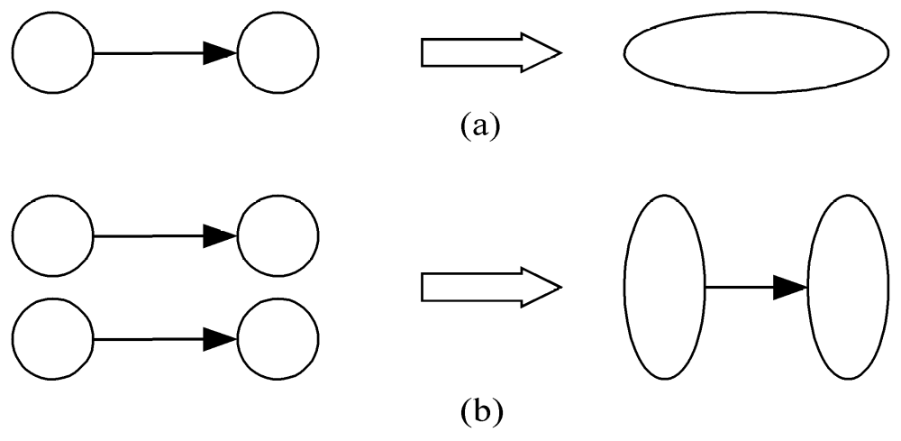
Agglomeration Can Improve Performance
Eliminate communication between primitive tasks agglomerated into consolidated task
Combine groups of sending and receiving tasks

Slide 16
Agglomeration Checklist
Locality of parallel algorithm has increased
Replicated computations take less time than communications they replace
Data replication doesn’t affect scalability
Agglomerated tasks have similar computational and communications costs
Number of tasks increases with problem size
Number of tasks suitable for likely target systems
Tradeoff between agglomeration and code modifications costs is reasonable

Slide 17
Mapping
Process of assigning tasks to processors
Centralized multiprocessor: mapping done by operating system
Distributed memory system: mapping done by user
Conflicting goals of mapping
  Maximize processor utilization
  Minimize interprocessor communication

Slide 18
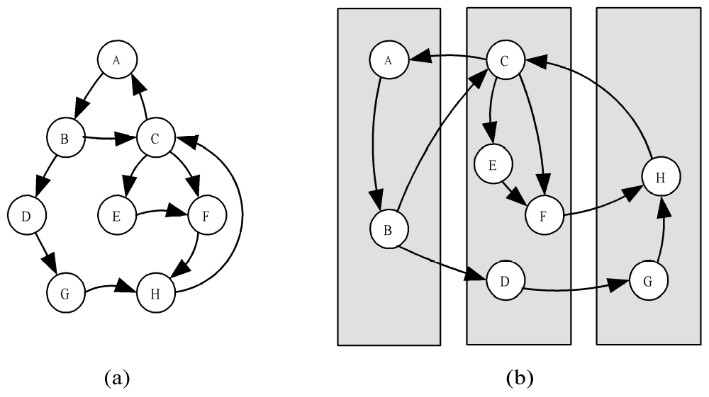
Mapping Example

Slide 19
Optimal Mapping
Finding optimal mapping is NP-hard
Must rely on heuristics

Slide 20
Mapping Decision Tree
Static number of tasks
  Structured communication
    Constant computation time per task
      Agglomerate tasks to minimize comm
      Create one task per processor
    Variable computation time per task
      Cyclically map tasks to processors
  Unstructured communication
      Use a static load balancing algorithm
Dynamic number of tasks

Slide 21
Mapping Strategy
Static number of tasks
Dynamic number of tasks
  Frequent communications between tasks
    Use a dynamic load balancing algorithm
  Many short-lived tasks
    Use a run-time task-scheduling algorithm

Slide 22
Mapping Checklist
Considered designs based on one task per processor and multiple tasks per processor
Evaluated static and dynamic task allocation
If dynamic task allocation chosen, task allocator is not a bottleneck to performance
If static task allocation chosen, ratio of tasks to processors is at least 10:1

Slide 23
Case Studies
Boundary value problem
Finding the maximum
The n-body problem
Adding data input

Slide 24
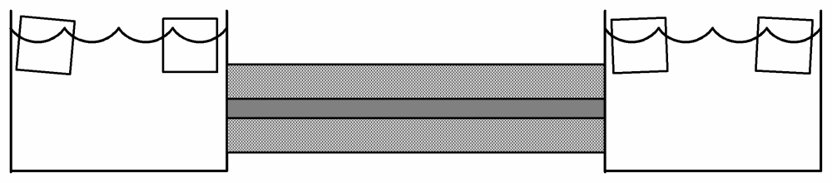
Boundary Value Problem
Ice water
Rod
Insulation

Slide 25
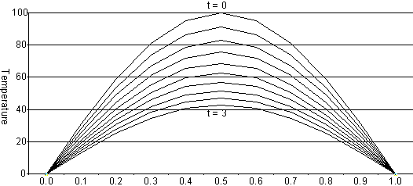
Rod Cools as Time Progresses

Slide 26
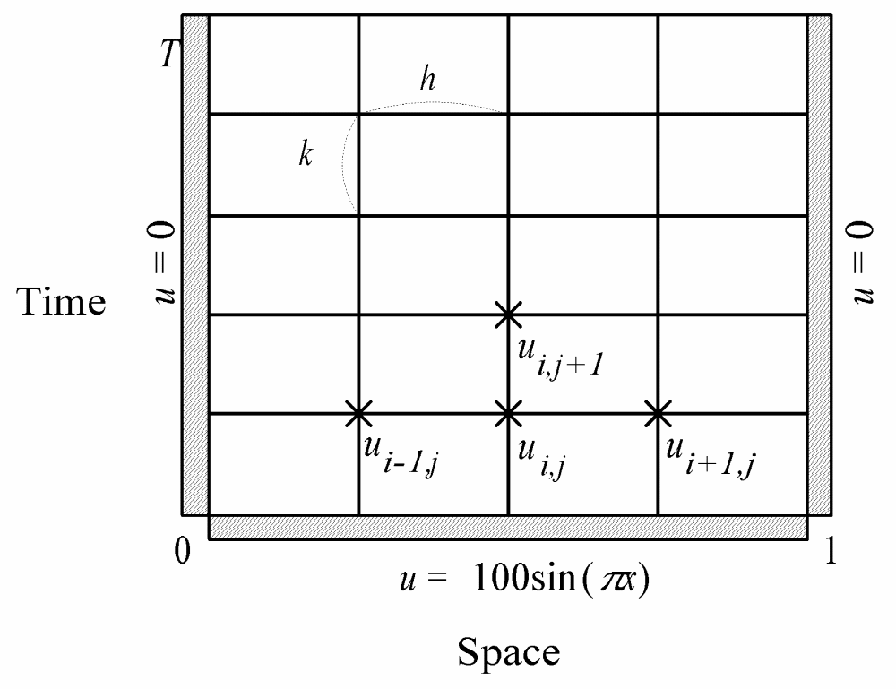
Finite Difference Approximation

Slide 27
Partitioning
One data item per grid point
Associate one primitive task with each grid point
Two-dimensional domain decomposition

Slide 28
Communication
Identify communication pattern between primitive tasks
Each interior primitive task has three incoming and three outgoing channels

Slide 29
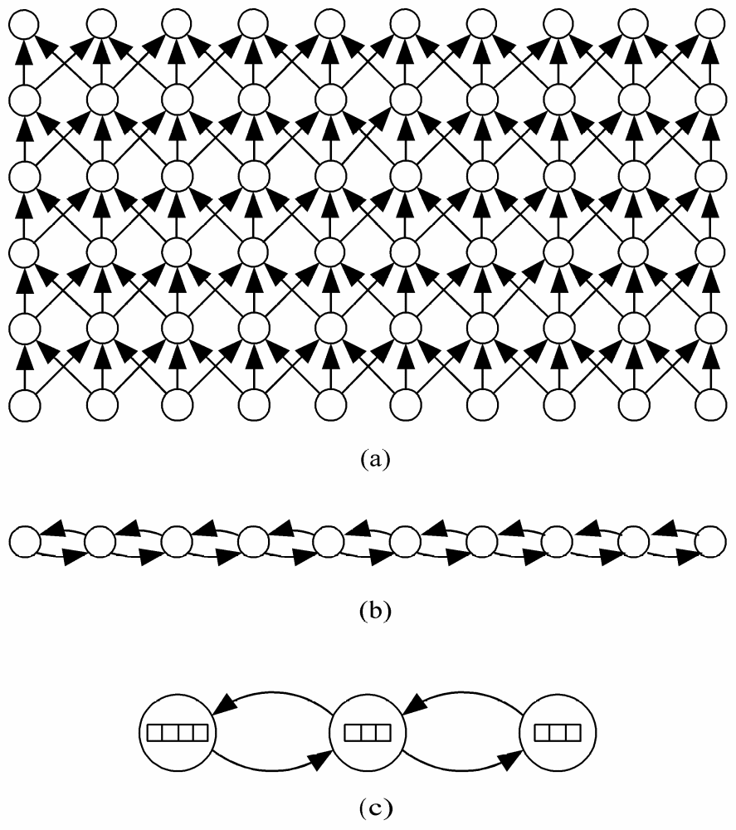
Agglomeration and Mapping
Agglomeration

Slide 30
Sequential execution time
χ – time to update element
n – number of elements
m – number of iterations
Sequential execution time: m (n-1) χ

Slide 31
Parallel Execution Time
p – number of processors
λ – message latency
Parallel execution time m(χ⎡(n-1)/p⎤+2λ)

Slide 32

Finding the Maximum Error
6.25%

Slide 33
Reduction
Given associative operator ⊕
a₀ ⊕ a₁ ⊕ a₂ ⊕ … ⊕ a_{n-1}
Examples
  Add
  Multiply
  And, Or
  Maximum, Minimum

Slide 34
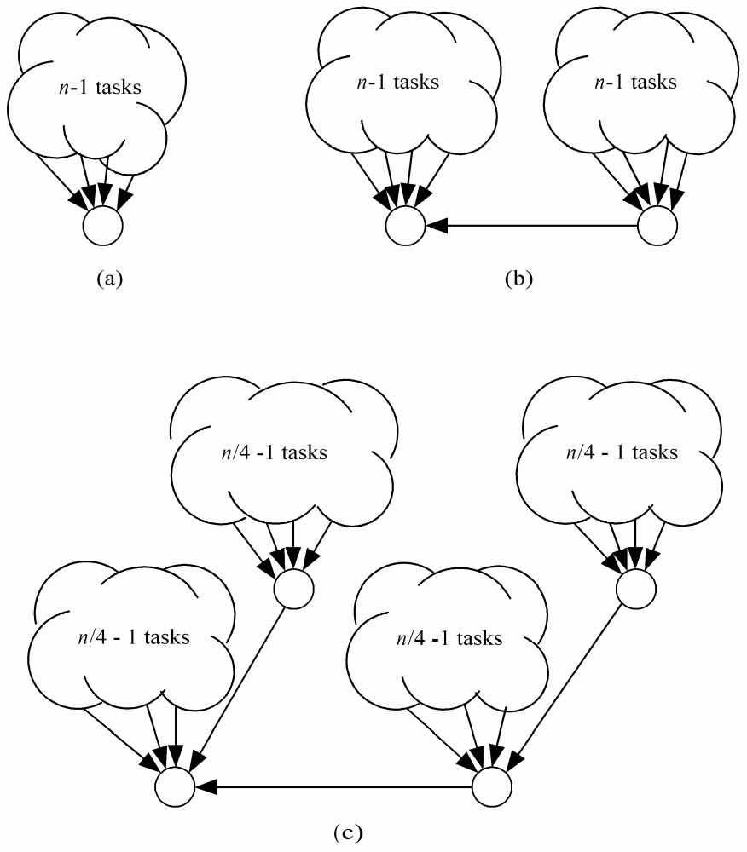
Parallel Reduction Evolution

Slide 35

Parallel Reduction Evolution

Slide 36
Parallel Reduction Evolution

Slide 37
Binomial Trees
Subgraph of hypercube

Slide 38
Finding Global Sum
4
2
0
7
-3
5
-6
-3
8
1
2
3
-4
4
6
-1

Slide 39
Finding Global Sum
1
7
-6
4
4
5
8
2

Slide 40
Finding Global Sum
8
-2
9
10

Slide 41
Finding Global Sum
17
8

Slide 42
Finding Global Sum
Binomial Tree
25

Slide 43
Agglomeration

Slide 44
Agglomeration
sum
sum
sum
sum

Slide 45
The n-body Problem

Slide 46
The n-body Problem

Slide 47
Partitioning
Domain partitioning
Assume one task per particle
Task has particle’s position, velocity vector
Iteration
  Get positions of all other particles
  Compute new position, velocity

Slide 48
Gather

Slide 49
All-gather

Slide 50
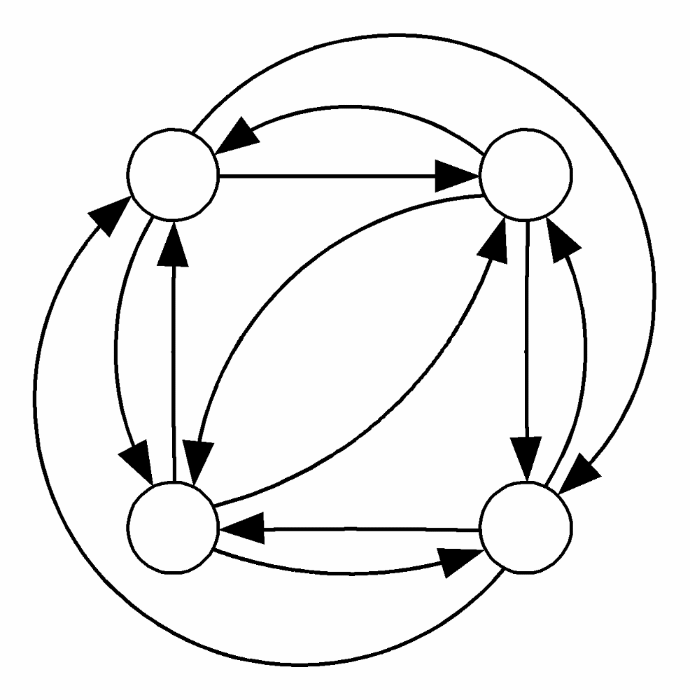
Complete Graph for All-gather

Slide 51
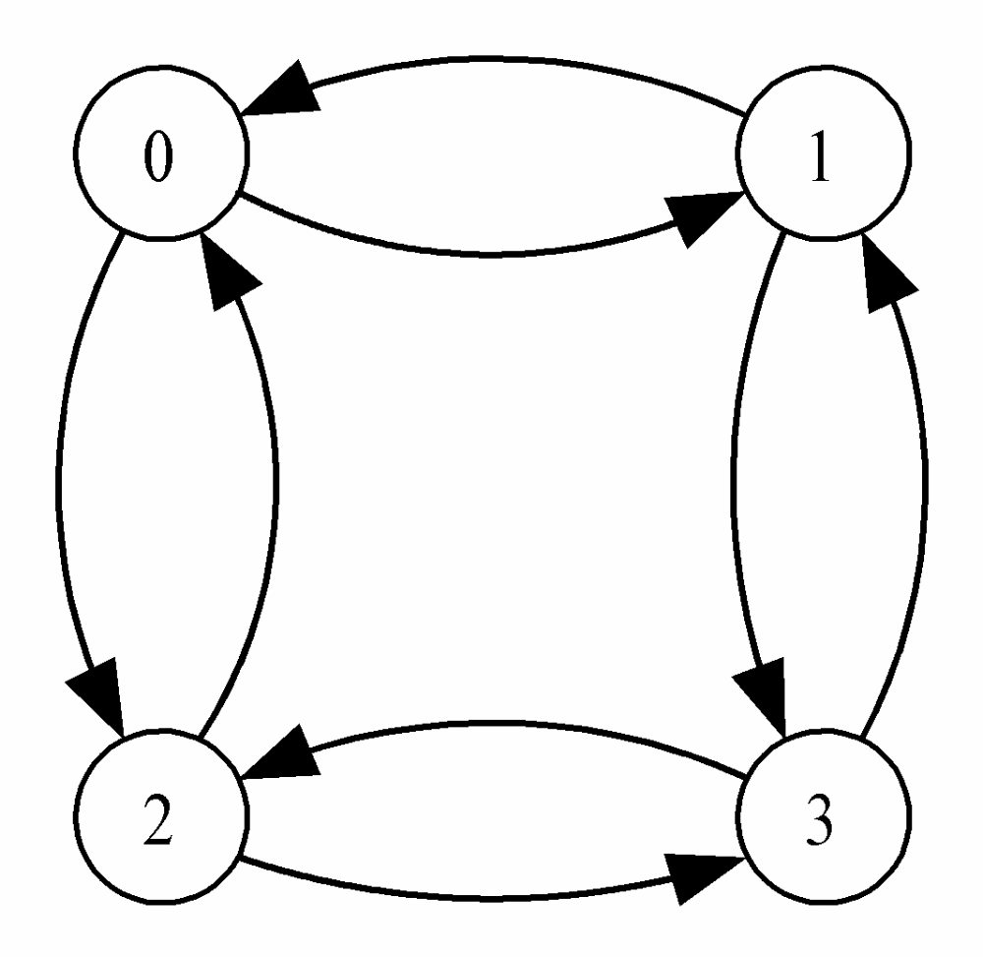
Hypercube for All-gather

Slide 52
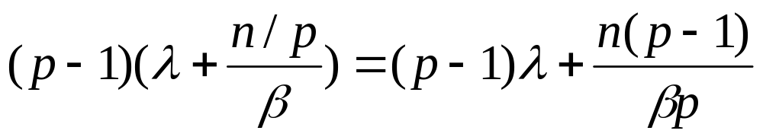
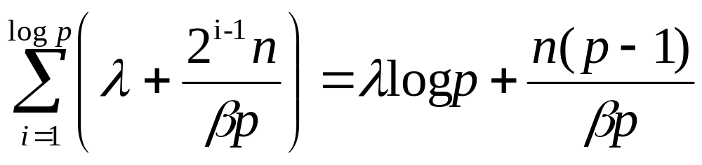
Communication Time
Complete graph
Hypercube

Slide 53
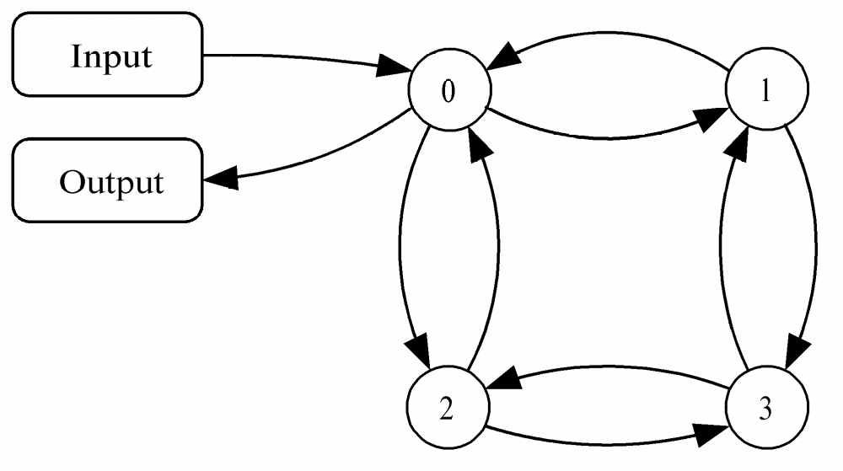
Adding Data Input

Slide 54
Scatter

Slide 55
Scatter in log p Steps
12345678
1234
12
5678
56
34
78

Slide 56
Summary: Task/channel Model
Parallel computation
  Set of tasks
  Interactions through channels
Good designs
  Maximize local computations
  Minimize communications
  Scale up

Slide 57
Summary: Design Steps
Partition computation
Agglomerate tasks
Map tasks to processors
Goals
  Maximize processor utilization
  Minimize inter-processor communication

Slide 58
Summary: Fundamental Algorithms
Reduction
Gather and scatter
All-gather

